Slide 1

Learning Environment – a Guided Tour
Hardware
Operating System
VM
Docker
Git
Github
Jupyter
Python
Regular Expressions
Matlab
Apache Spark
Kafka
And a lot more …….

Slide 2
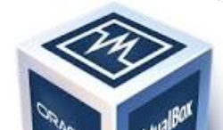
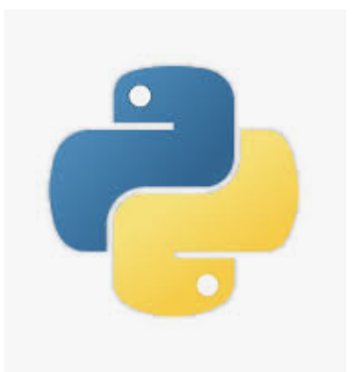

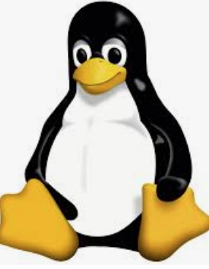
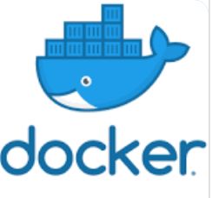

Slide 3
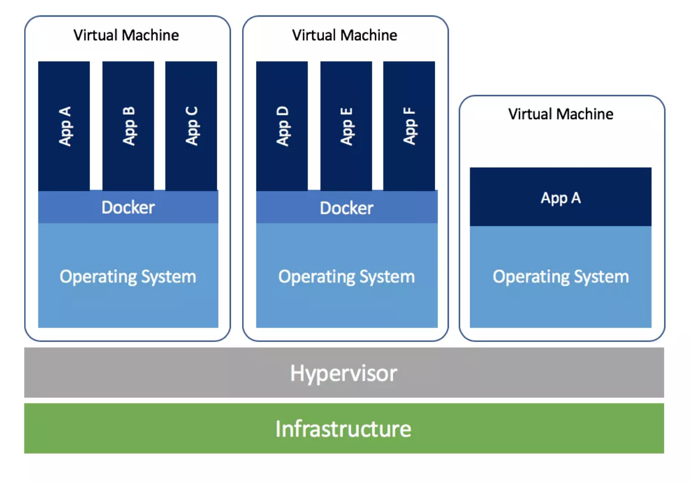
Virtual Machines and Docker
Hardware
VM
Docker

Slide 4
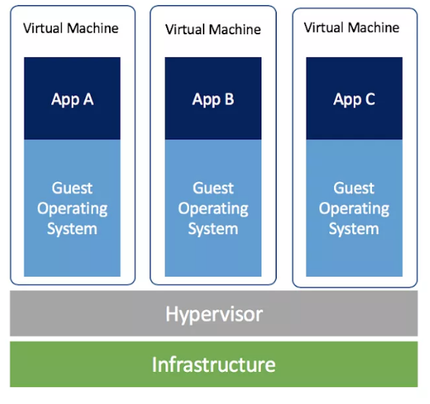
Virtual Machine

Slide 5
VM – Advantages [credit]
Familiar Interface
Isolation – each machine runs on its own resources
High Availability – if one machine fails, spin up another
Scalablity – add or remove machines as needed
Backup and fast recovery
Cost Reduction – share resources

Slide 6
VM – Disadvantages [credit]
Difficult to directly access hardware
Uses a lot of RAM or memory – each machine allocated its own memory stack
Uses a lot of disk space – again each machine allocated its own space
Machine is less efficient than actual machine – has to go through the hypervisor

Slide 7
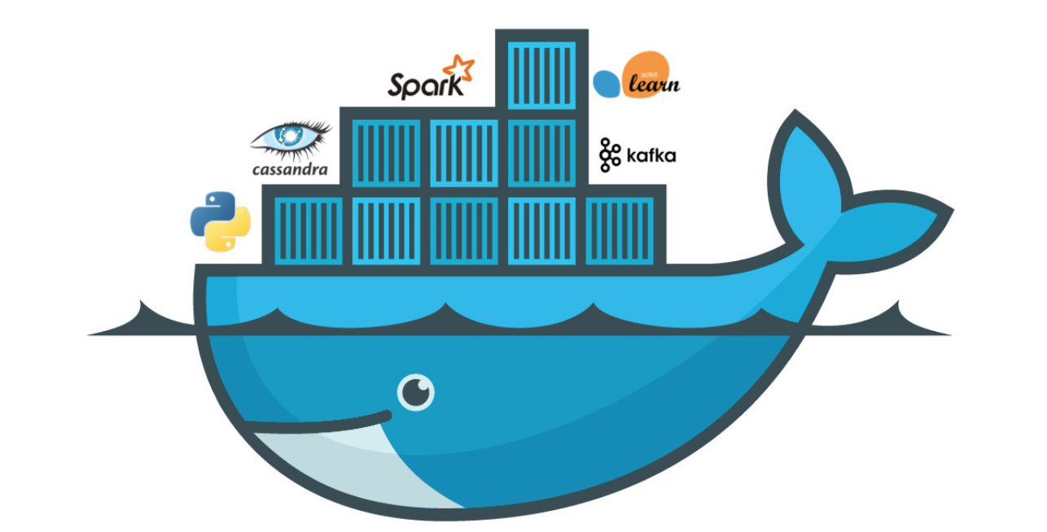

Slide 8

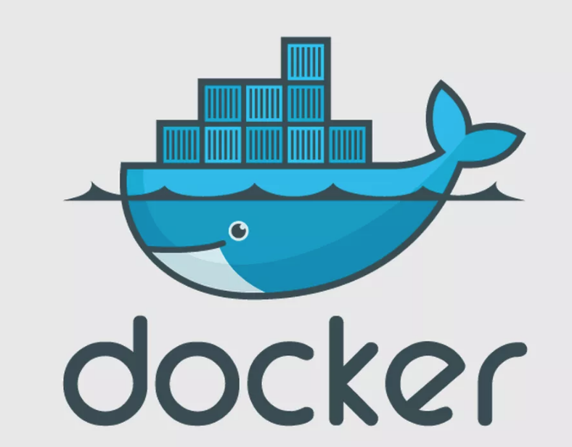
Docker
Docker is a tool that allows developers, sys-admins etc. to easily deploy their applications in a sandbox (called containers) to run on the host operating system i.e. Linux.
The key benefit of Docker is that it allows users to package an application with all of its dependencies into a standardized unit.
Unlike virtual machines, containers do not have the high overhead and hence enable more efficient usage of the underlying system and resources.

Slide 9

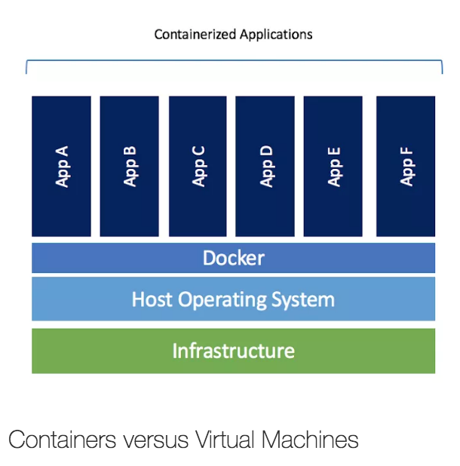
Sample Footer Text
1/25/19
3

Slide 10

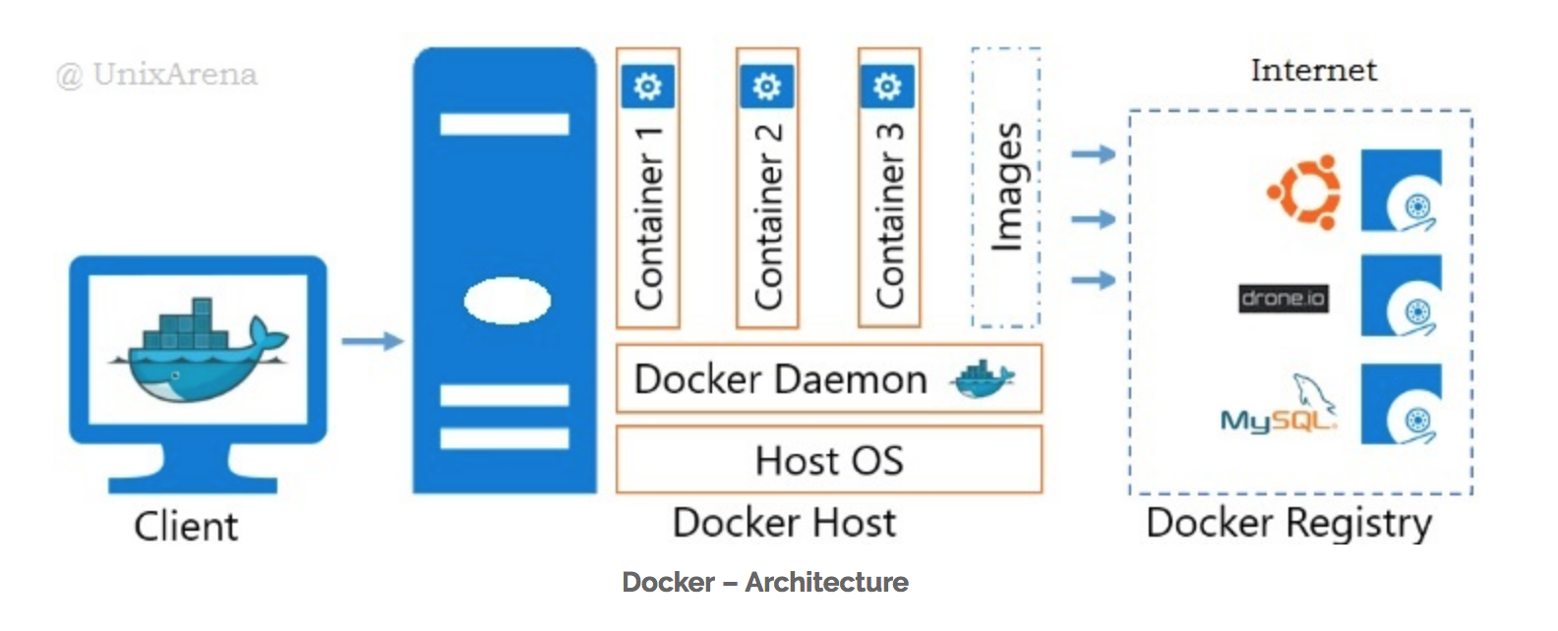
Docker Architecture [credit]

Slide 11
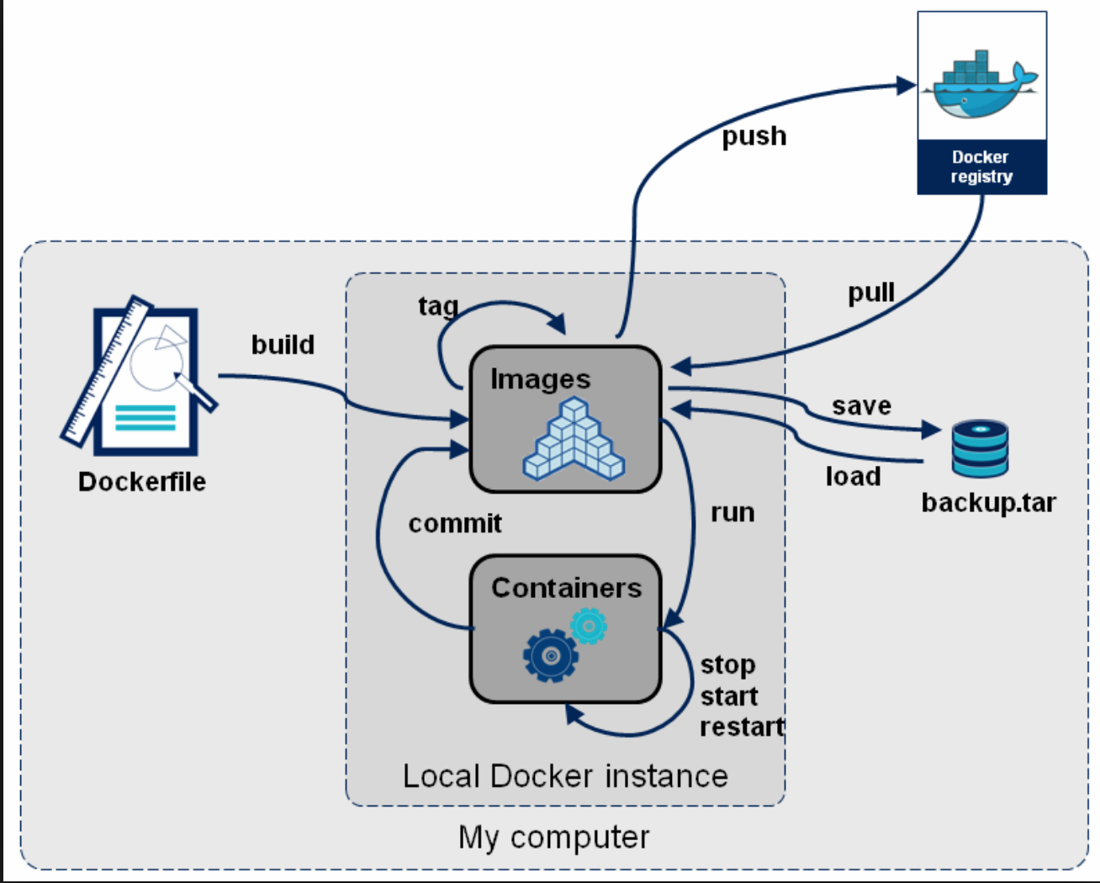
Docker LifeCycle

Slide 12
Docker Container VS Image
Pull image from Docker hub or build from a Dockerfile => Gives a Docker image (not editable)
docker pull sequenceiq/hadoop-docker:2.7.0
Run the image (docker run image_name:tag_name) => Gives a running Image i.e. container (editable)
docker run -it --name hdfs sequenceiq/hadoop-docker:2.7.0 /etc/bootstrap.sh -bash

Slide 13
Create Docker Image from Dockerfile
$ docker build --no-cache
$ docker build -t REPOSITORY[:tag] .

Slide 14
Pull/Push Docker Image to Repository
$ docker push REPOSITORY[:tag]
$ docker pull REPOSITORY[:tag]
$ docker search KEYWORDS

Slide 15
Docker Images
$ docker images –a
$ docker rmi IMAGE
$ docker history IMAGE
$ docker inspect IMAGE

Slide 16
Create Docker Container from Image
$ docker run [OPTIONS] REPOSITORY[:TAG] CMD # run=create+start
$ docker run -i -t -d -p 80:80 REPOSITORY[:TAG] CMD

Slide 17
Docker Containers
$ docker ps # all running containers
$ docker ps –a # all containers
$ docker create IMAGE
$ docker start CONTAINER
$ docker stop CONTAINER
$ docker kill CONTAINER
$ docker rm [CONTAINER...]

Slide 18
“ssh” into Docker Container
$ docker exec CONTAINER CMD
$ docker exec -it CONTAINER CMD

